Slide 1

Crime Rate per Capita Income US Counties
Team 3
Kevin Ybarra
Satya Sakuntala NagaSravya Mattapalli
Chris Schultz
Wei Kent Chen

Slide 2
Project Overview
Team 3 project compares United State counties per capita income and crime rate.
Our project gathers data on counties per capital income and crime rate in the United States, as well GeoJSON data to map out counties in the United States.

Slide 3
Data Sources
Kaggle - United States counties by per capita income
Kaggle - United States crime rates by county
GeoJSON - US Counties

Slide 4
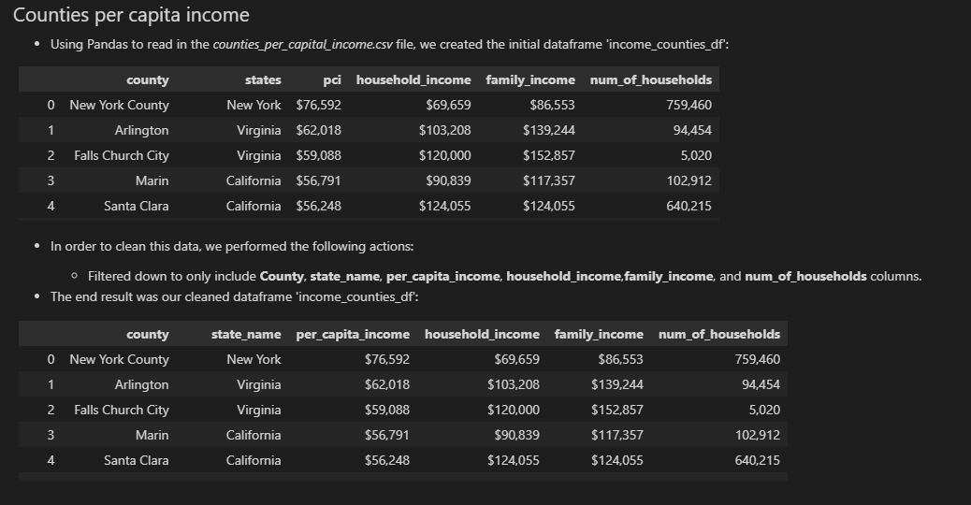
Transform Data – Counties per Capita Income

Slide 5
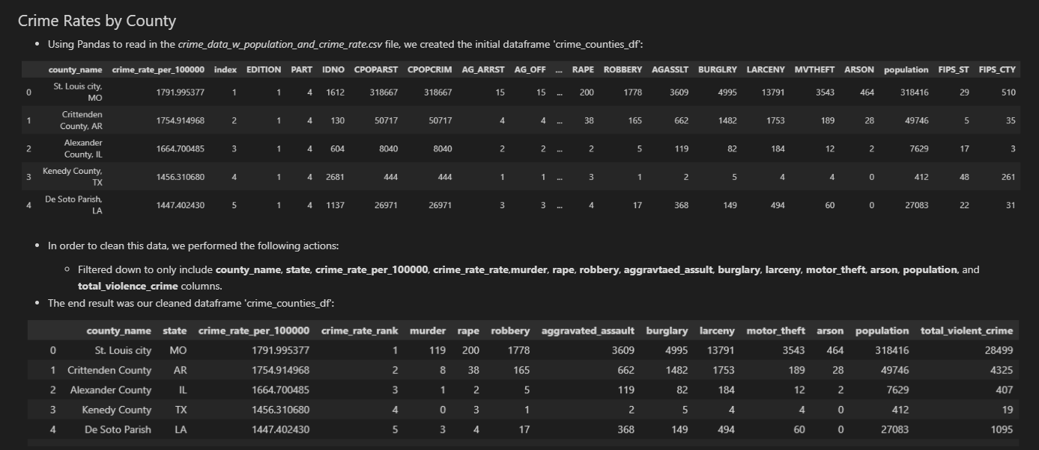
Transform Data – Crime Rates by County

Slide 6
Crime Rate per Capita Income US Counties
Thank You
Team 3
Kevin Ybarra
Satya Sakuntala NagaSravya Mattapalli
Chris Schultz
Wei Kent Chen

